Slide 1


BDAT 1007 Social Data Mining Techniques Assignment #2
Harmilap Singh Dhaliwal

Slide 2

Tools and Techniques

Slide 3





Tools and Techniques used
Tweepy
Mongo DB ATLAS
PRAW
FLASK

Slide 4




Tools and Techniques used (Cont.)
JavaScript
CSS
HTML
AJAX

Slide 5




Tools and Techniques used (Cont.)
jQuery
Tiny MCE
BOOTSTRAP
Data tables

Slide 6

Data Model

Slide 7
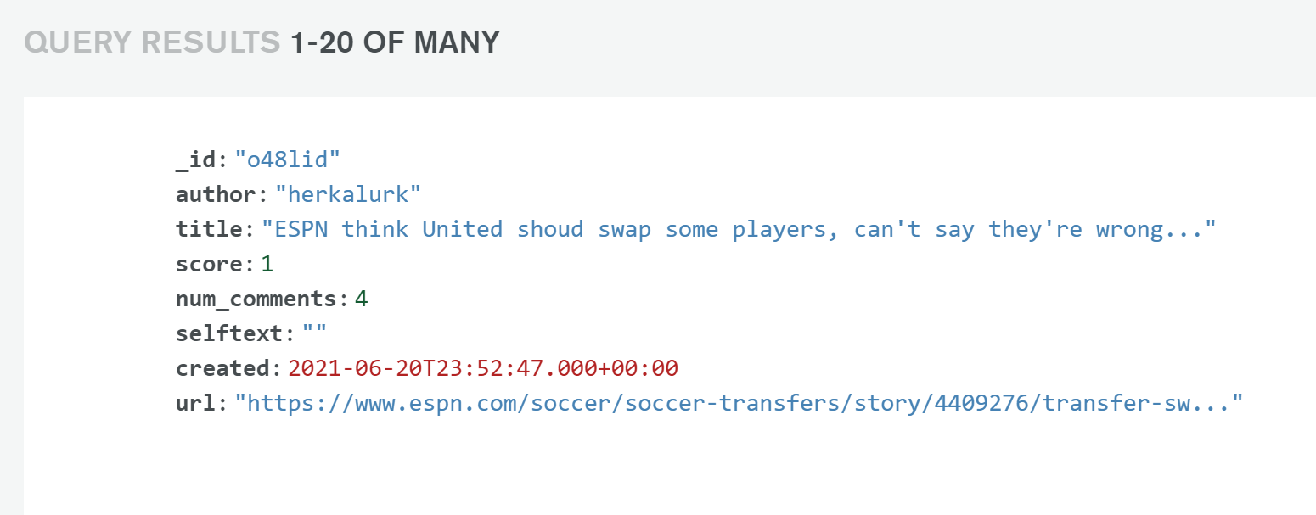
Data Model ( )
Sr.No. | Variable Name
1 | Time Created
2 | Author
3 | Title
4 | Score
5 | Number of Comments
6 | Post
7 | Link

Slide 8

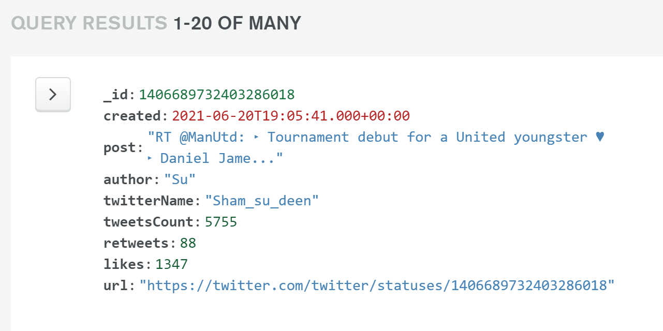
Data Model ( )
Sr.No. | Variable Name
1 | Time Created
2 | Author
3 | Twitter Name
4 | Likes
5 | Retweets
6 | Post
7 | Number of Tweets
8 | Link

Slide 9
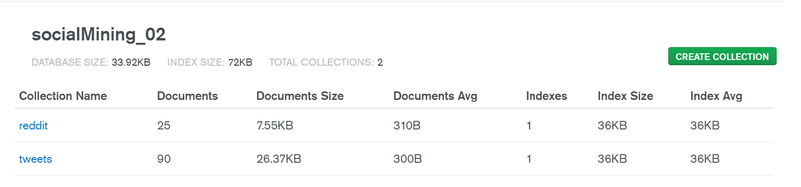
Mongo db Database

Slide 10


Social media data scraping (API)

Slide 11
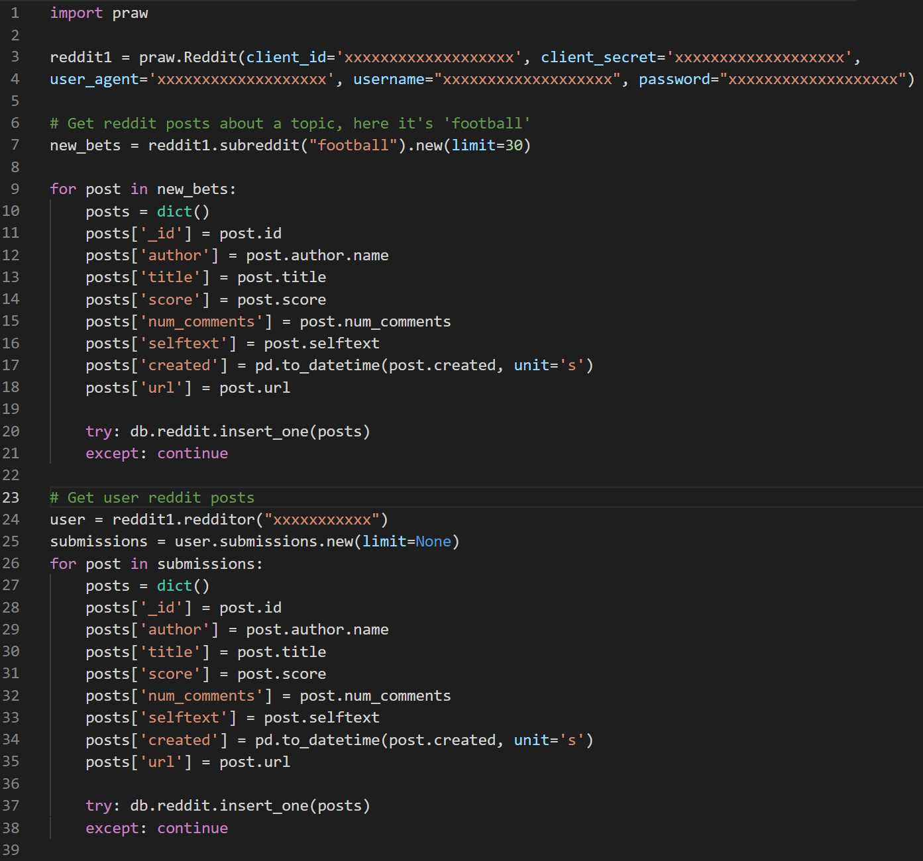
Scraping reddit using api and praw

Slide 12
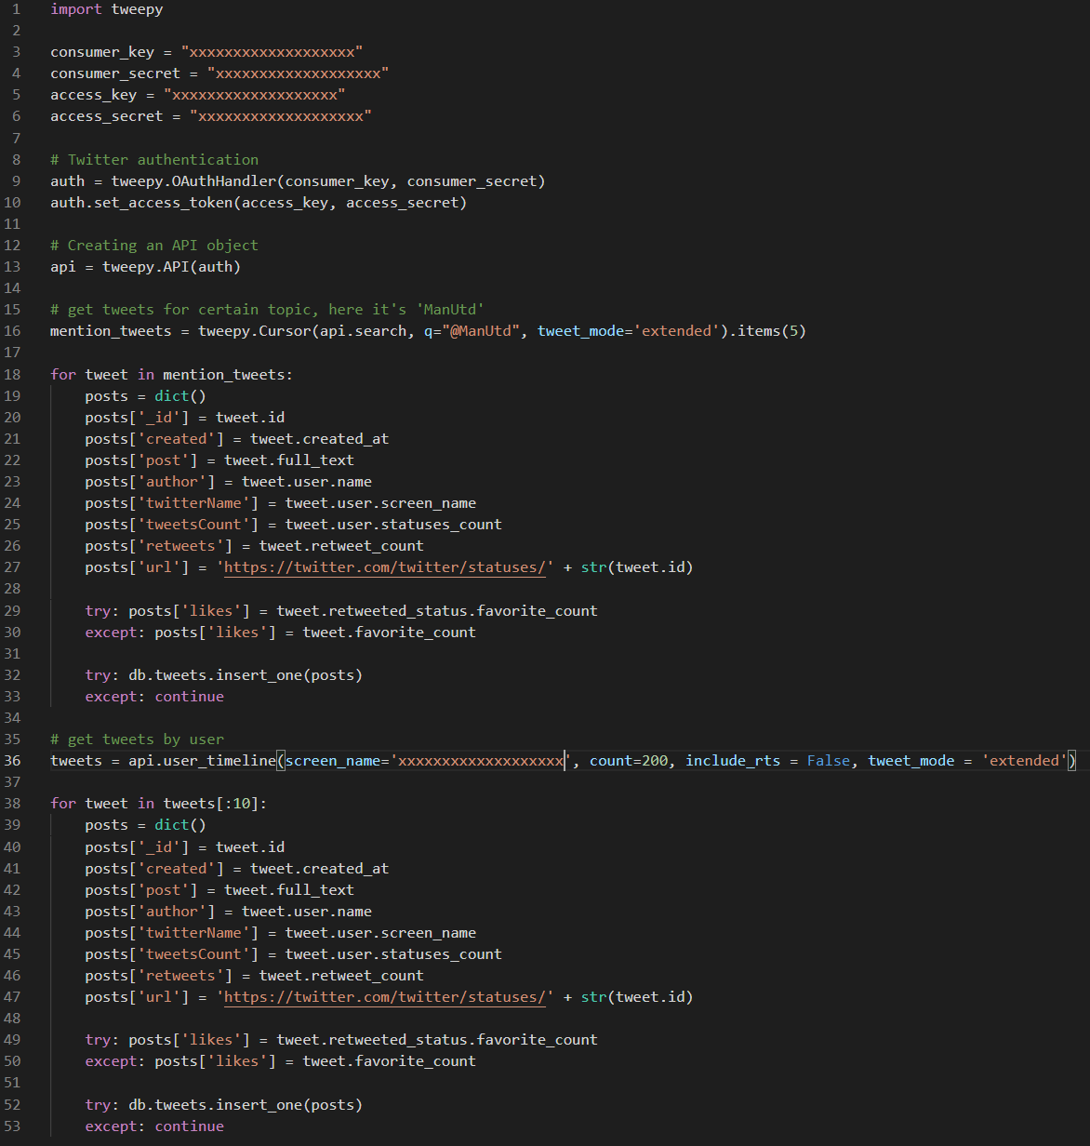
Scraping Twitter using api and Tweepy

Slide 13

Web application

Slide 14
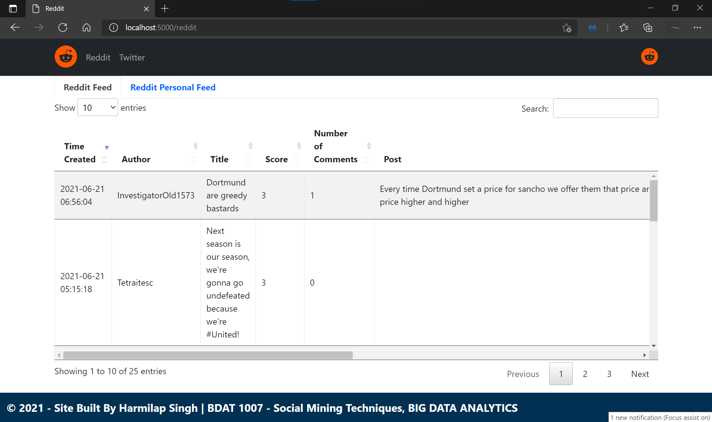
Web design elements

Slide 15
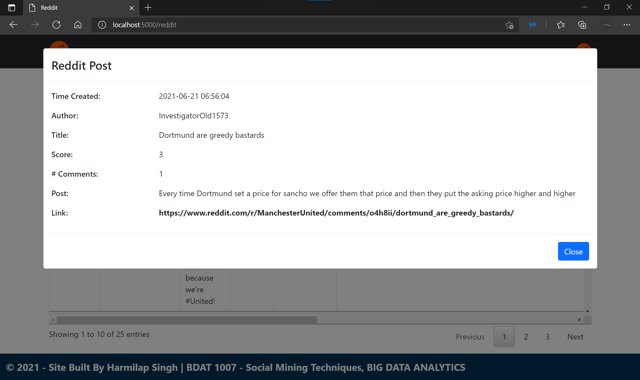
Web design elements

Slide 16
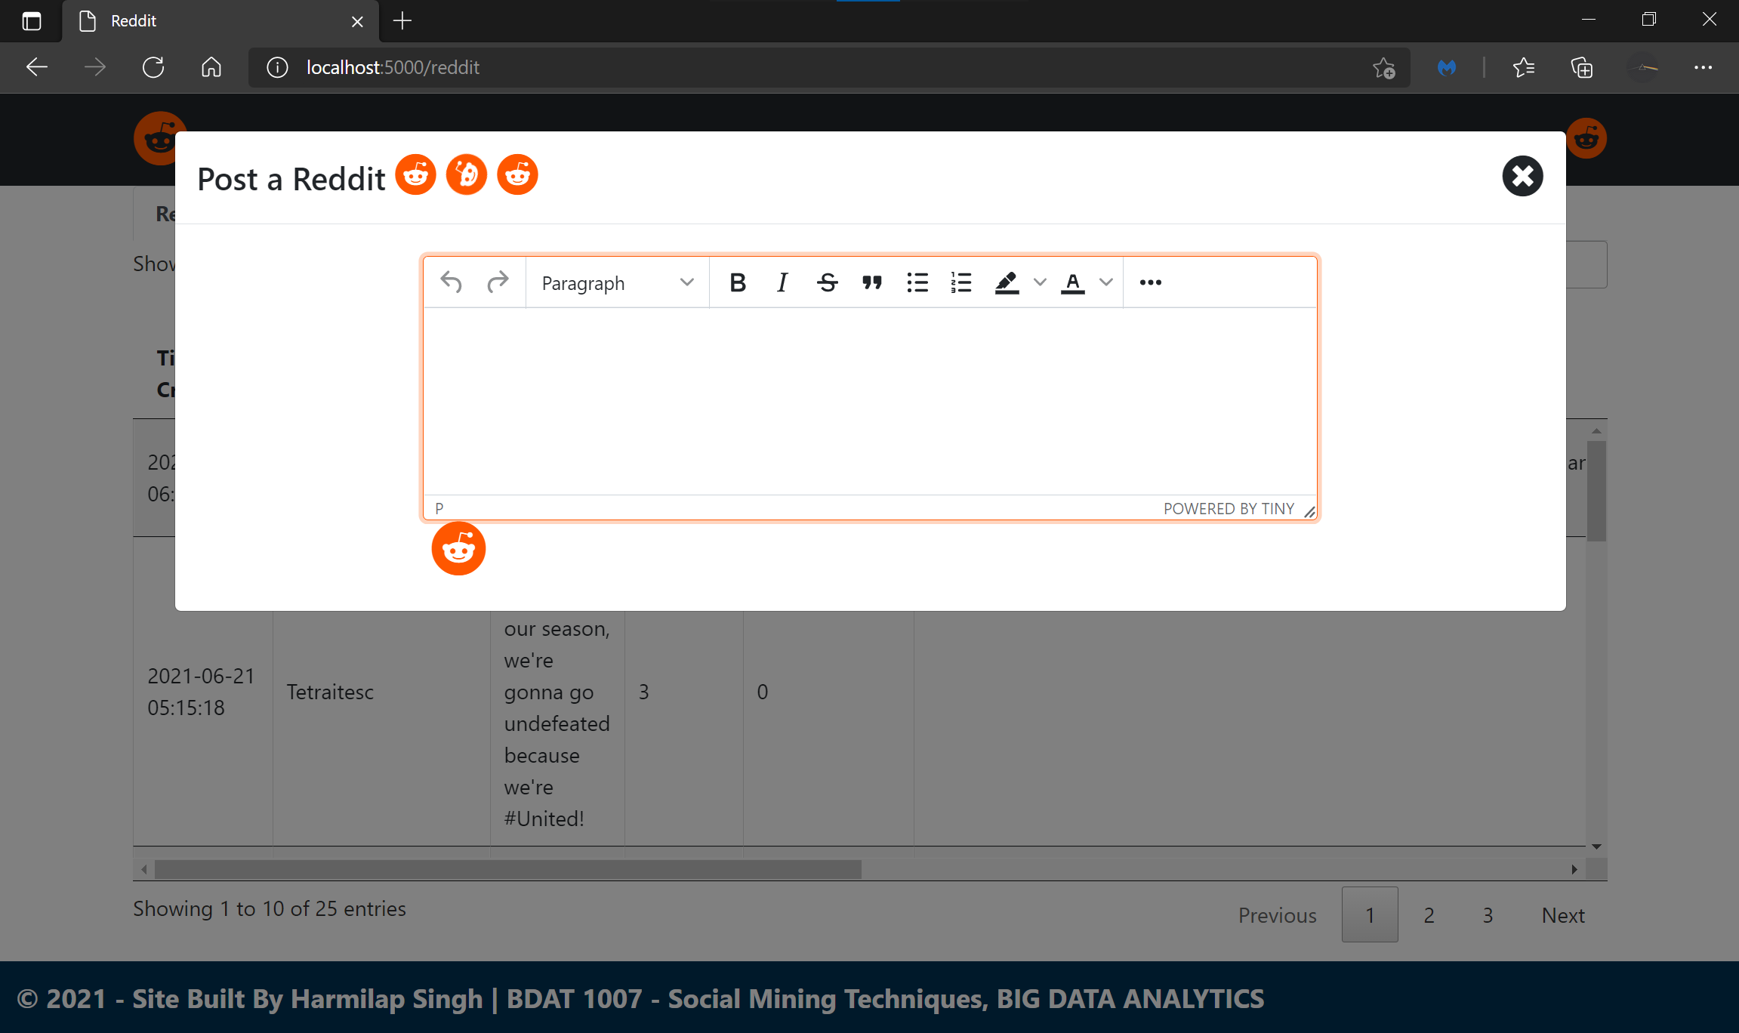
Web design elements

Slide 19
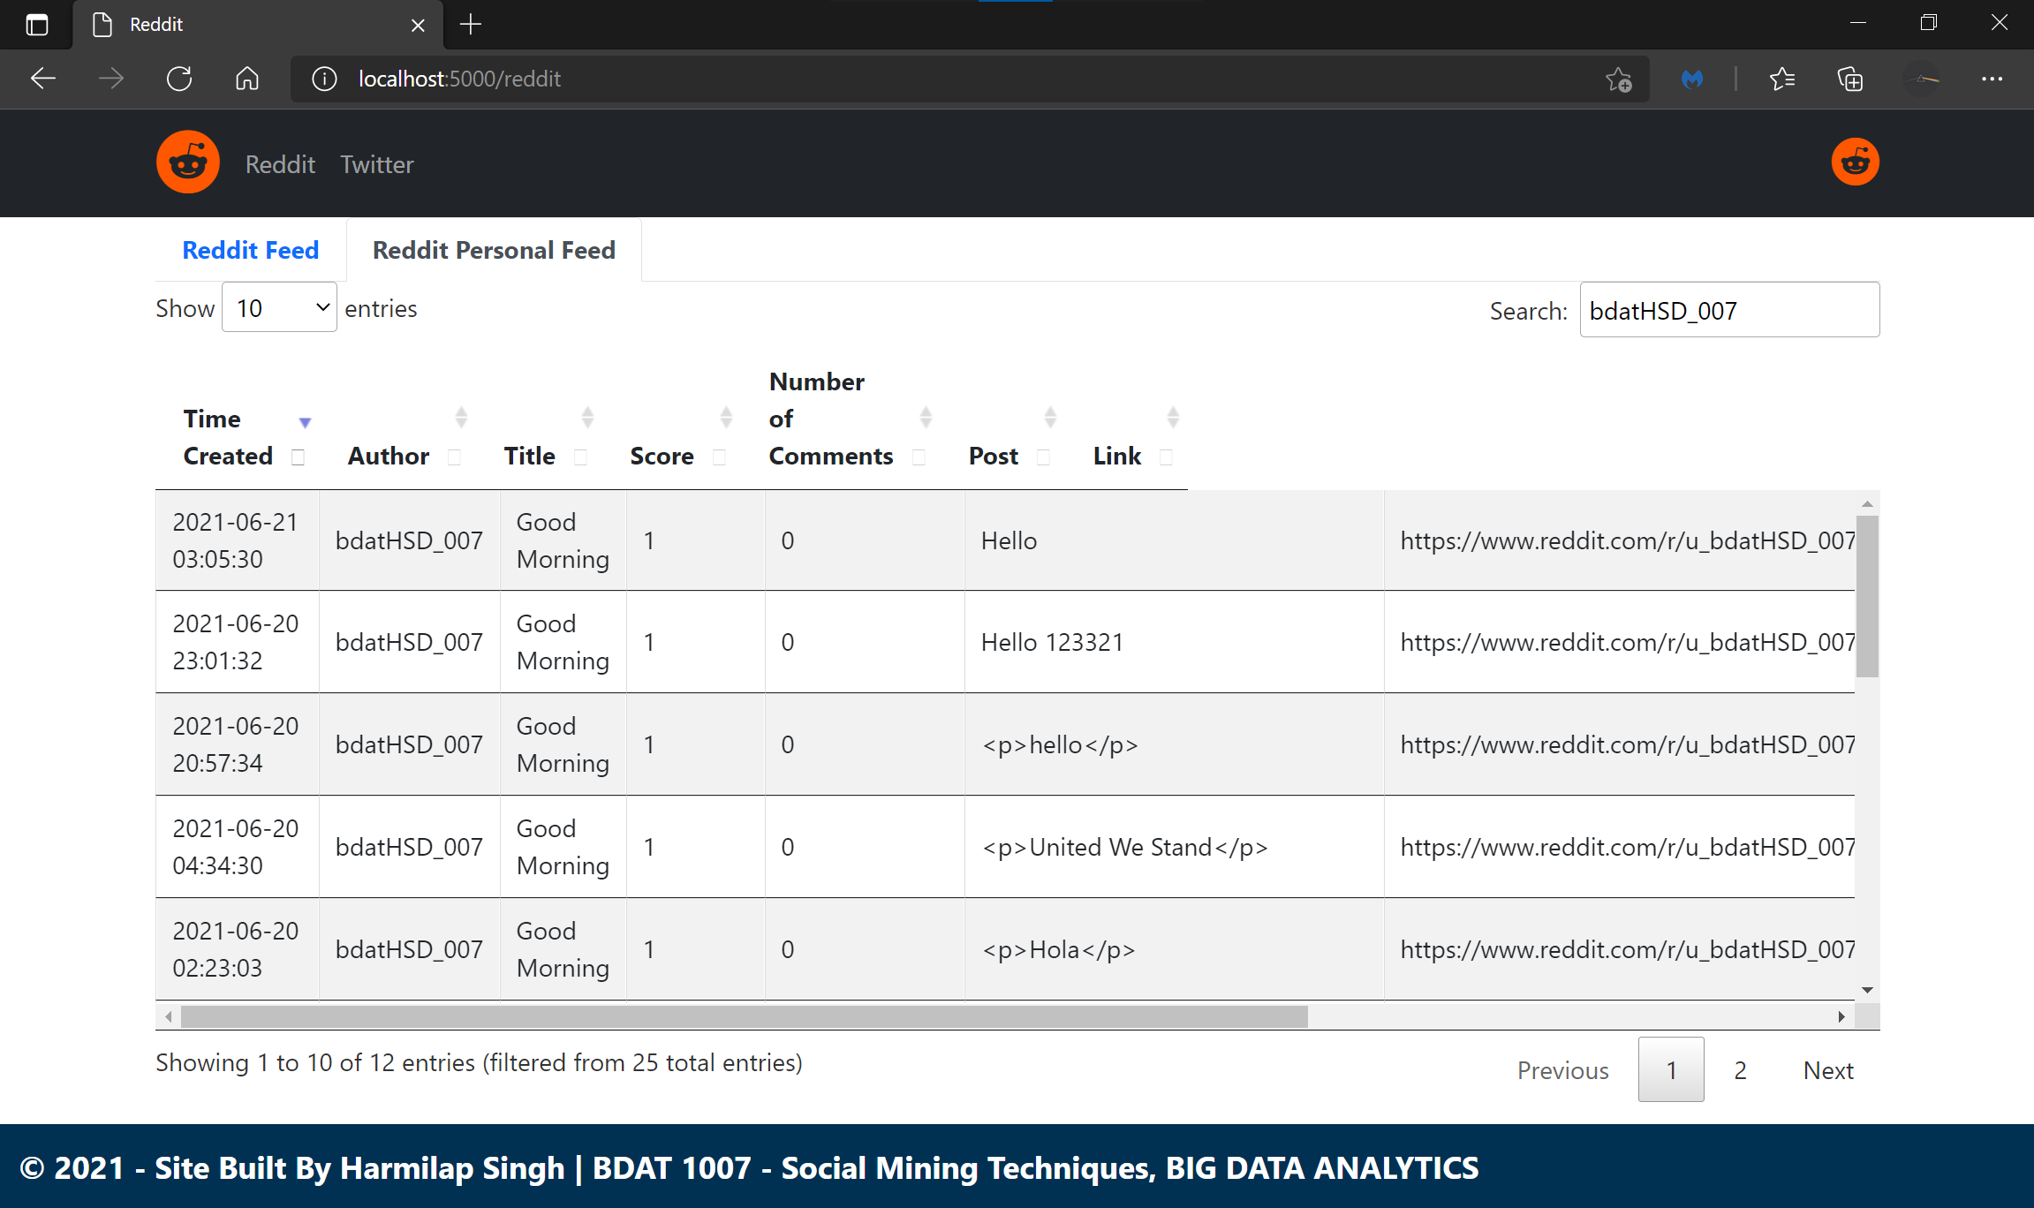

Slide 20
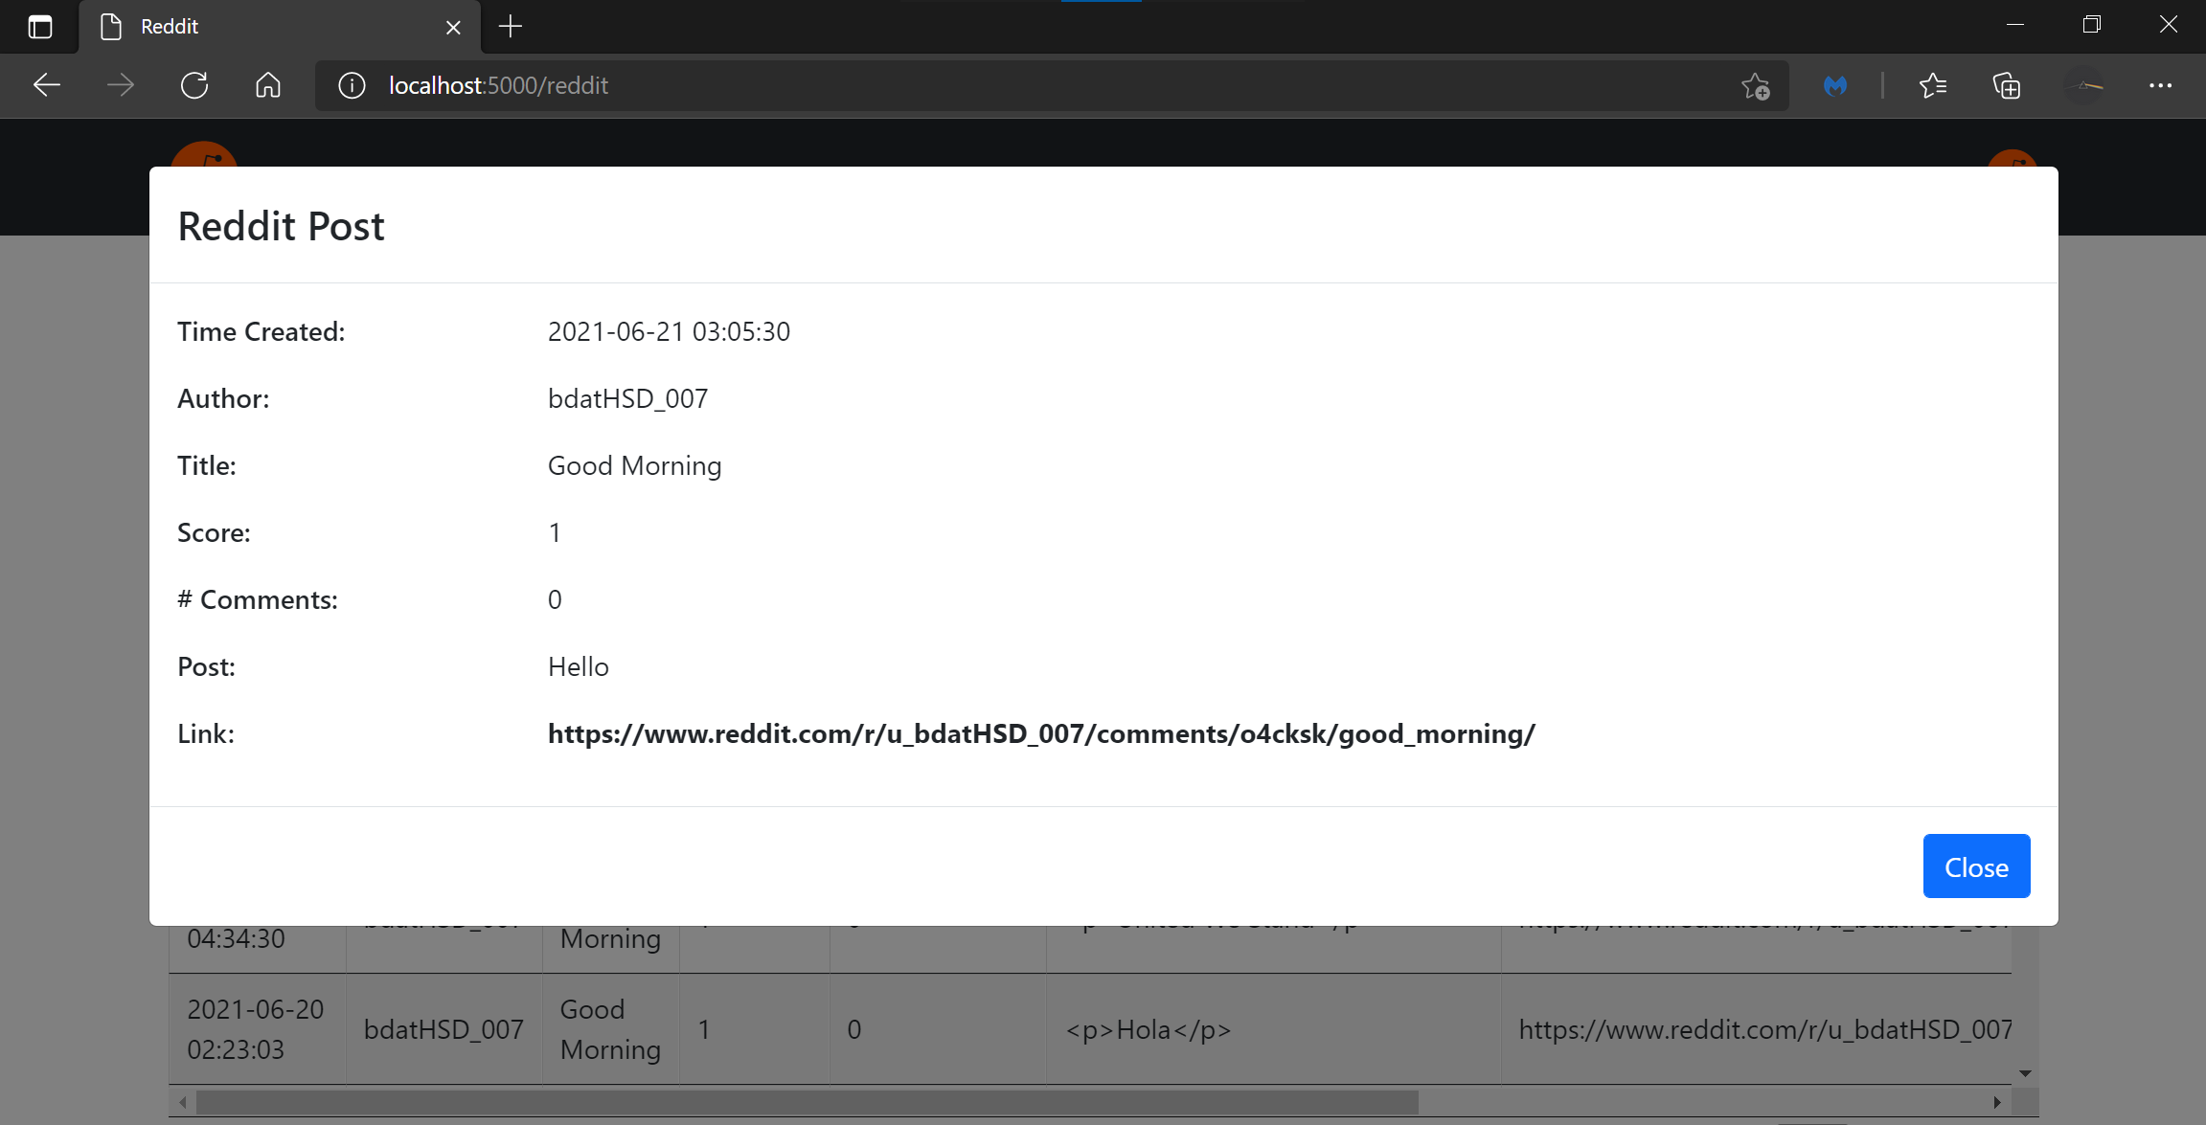

Slide 22
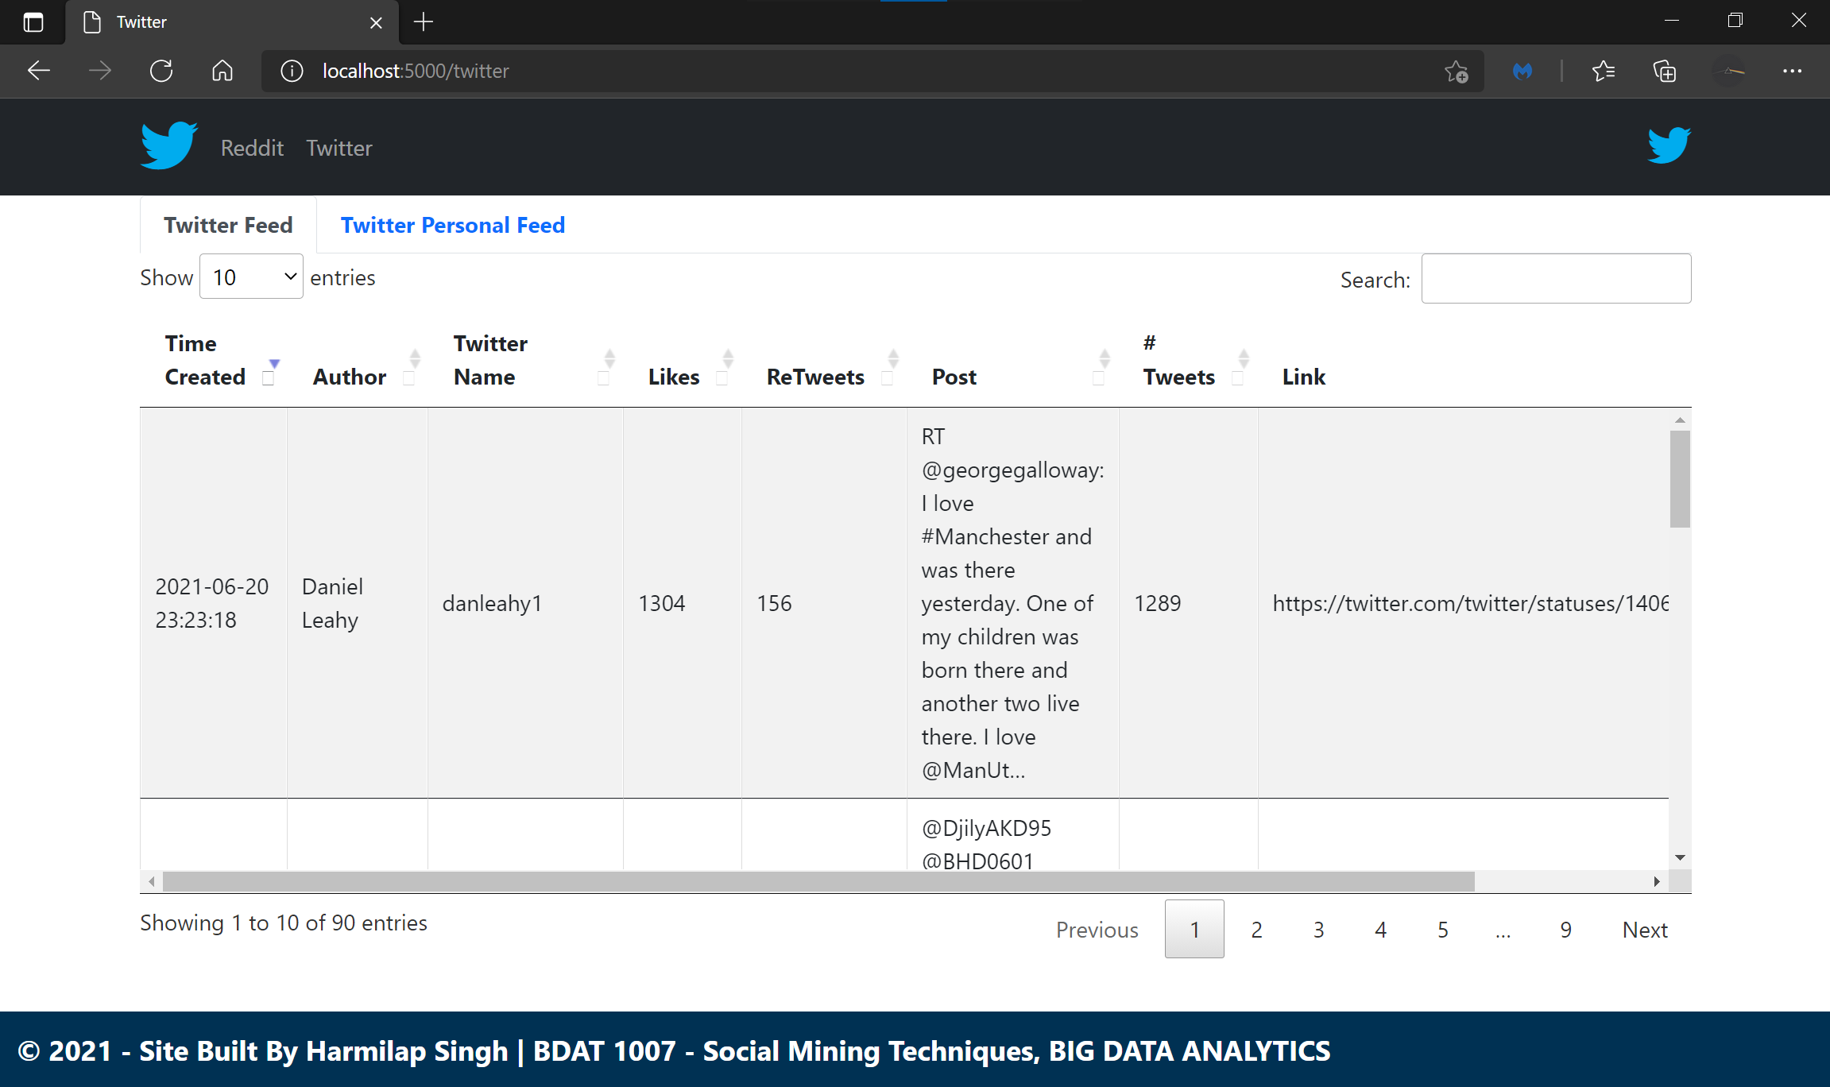

Slide 23
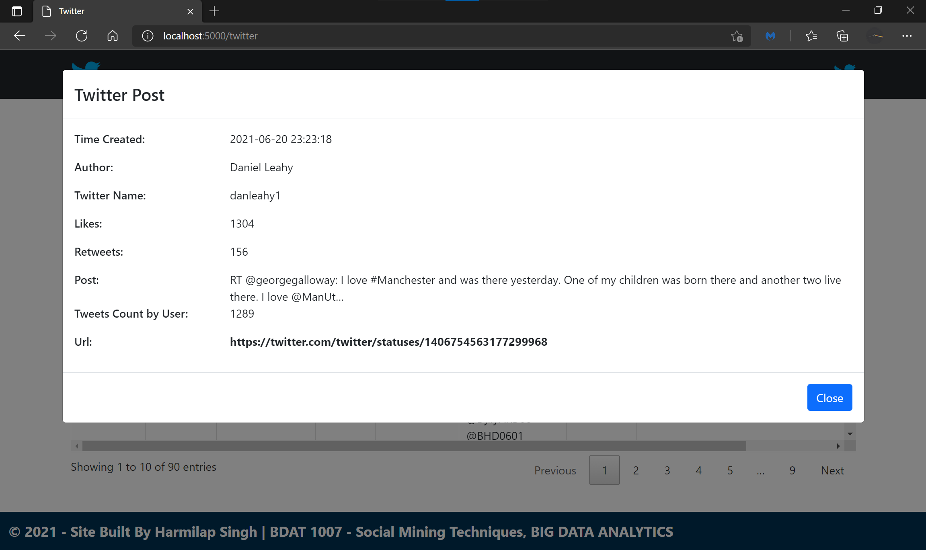

Slide 24
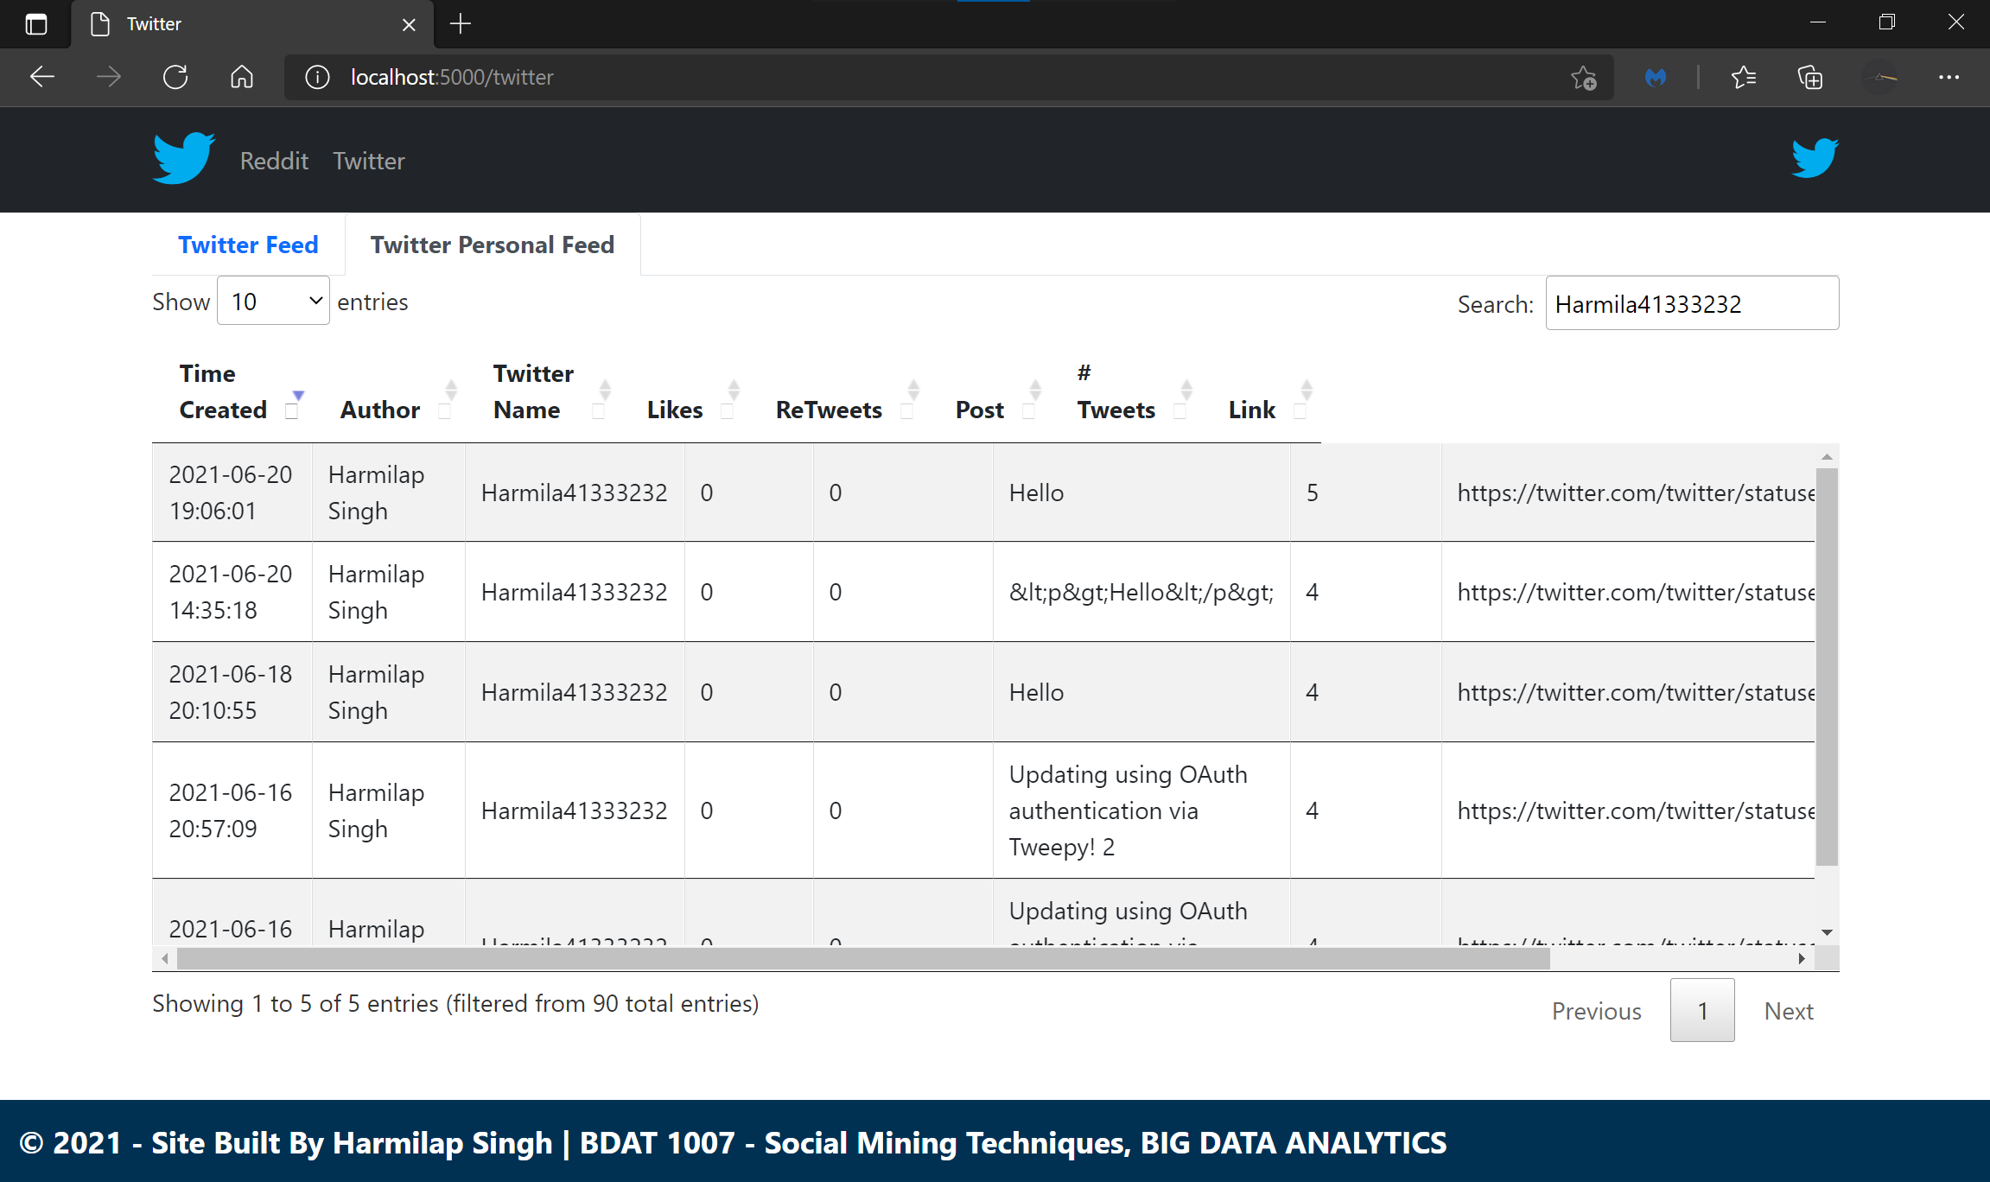

Slide 25
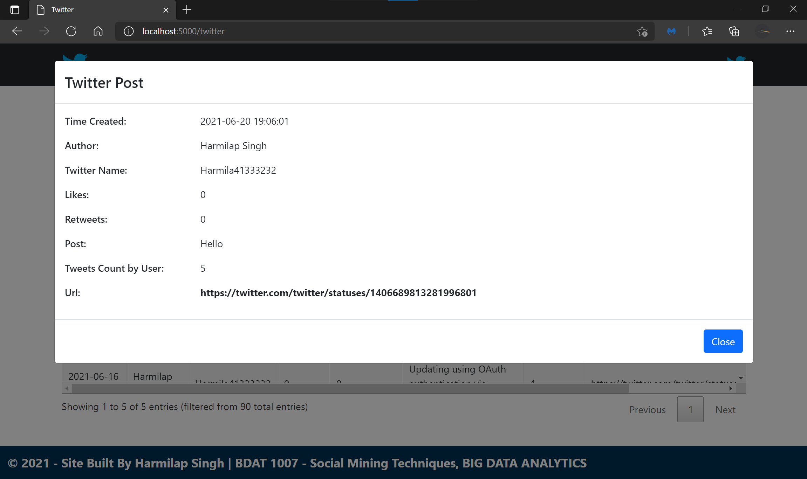

Slide 26
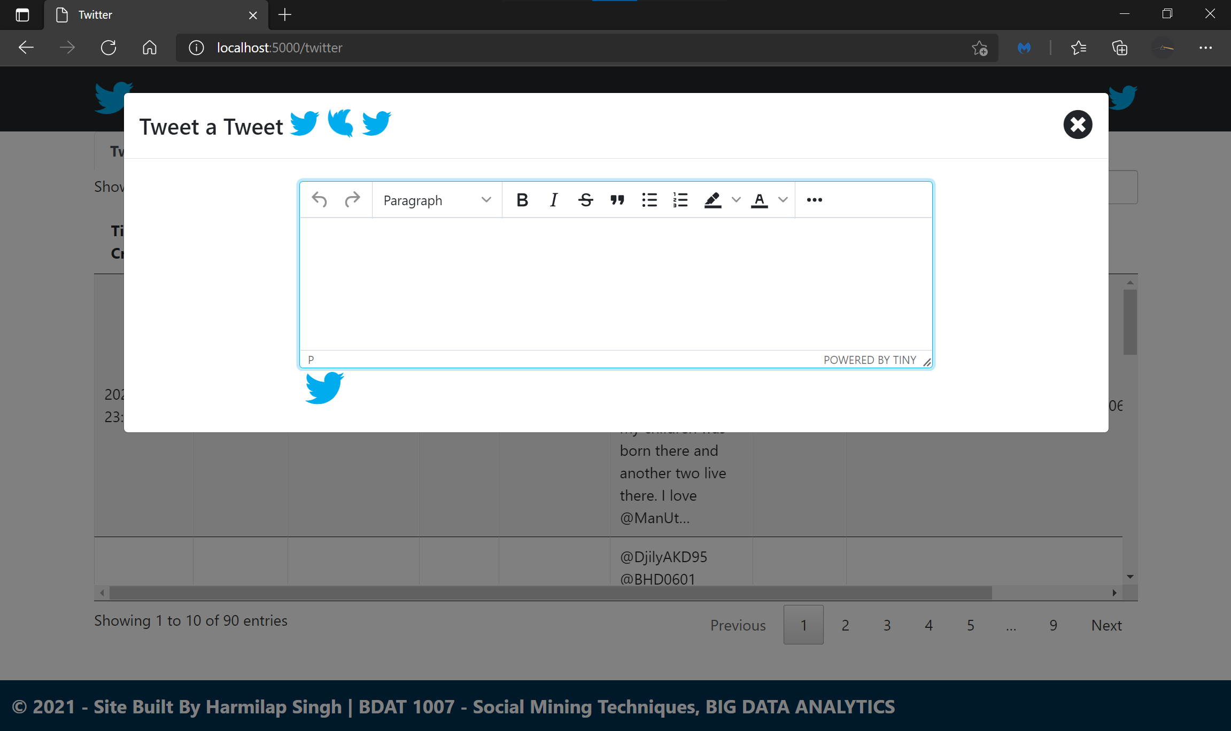

Slide 27
Resources & References
Open bootstrap modal pop on datatable row click event – Therichpost
How to scrape Reddit with Python – Storybench
Post on Reddit API With Python (PRAW) - JC Chouinard
How to Make a Twitter Bot in Python With Tweepy – Real Python
Bootstrap WYSIWYG editor - Enhance your Bootstrap form inputs with rich text (tiny.cloud)

Slide 28

THANK YOU

